Slide 1
Classical Planning
Partially Observable Markov Decision Process
6CCS3AIP – Artificial Intelligence Planning
Dr Tommy Thompson
Notes:
Welcome to this video on planning under uncertainty and in this video we follow on from our chapter on Markov Decision Processes to discuss what happens when you we break even more of the principles we have already established.
Once again, this is a very brief overview of how such issues are handled, but it is very much outside of the scope of our regular planning content. That said, it was important we briefly take a look at these concepts so that you begin to understand where planning works well and why.

Slide 2
Classical Planning = No Uncertainty
$$s7$$
$$s4$$
We assume the state is known.
We assume all states in the problem are known.
We assume that we know all actions from the current state.
We assume that a given action will always execute as intended.
We assume that the successor states of action execution are also known.
$$s8$$
$$s2$$
$$s5$$
$$sg$$
$$si$$
$$s9$$
$$s3$$
$$s6$$
$$s10$$
Notes:
To quickly recap the previous chapter, we discussed the idea of planning under uncertainty. So much of what we have covered in the module is built around a specific type of problem, where we know what state we’re in, we know the actions we’re currently able to execute and we know how they’re going to pan out. But this time around, we’re going for something a little different. What if we don’t know whether the actions are going to succeed as we have previously envisaged? What if the actions have a chance of not executing the way we want them to?
Now this is a pretty big problem, given that if this occurs, the state transition system no longer holds ground. We can’t assume what the successor state is because there is a chance it’s not going to behave as we have expected.

Slide 3
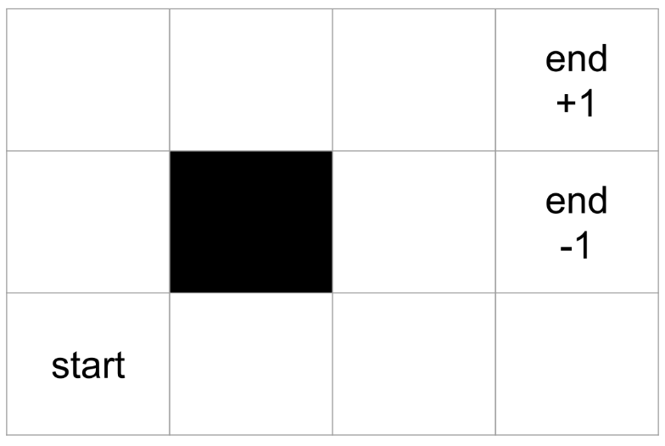
Recap: Markov Chains
0.7
S₁
S₂
Modelling probabilistic transitions between states.
Next state is only determined by probabilistic transition between states.
Does not factor the history of previous states.
Known as the Markov Property.
0.8
0.2
0.3
0.1
0.8
S₁
S₂
S₂
0.8
S₃
S₁
S₃
0.1
0.2
Notes:
Hence we begin to use the principle of Markov Chains, given this allows us to model the idea that a state can transition to other ones based on some probability.
If we have multiple states, we can encode what the odds are of moving from one of these states to another one. All of this is reliant on the principle of these systems known as the Markov property. This means that the transitions between states and the probabilities with which they occur can only happen as a result of the current state. Essentially, the system is memoryless, meaning that we don’t consider the history of states up to this point when thinking about how action transitions can happen.
The original notion of a Markov chain is that states merely have transitions and not explicit actions, but this is something that we can then explore using Markov Decision Processes.

Slide 4
Recap: Markov Decision Process (MDP)
A sequential decision making problem for a fully observable but stochastic environment.
Markov Chain holds, but now with probability of actions between states and rewards for action execution.
Reliant on two principles:
Assume that Markov property holds for action transitions (which it should).
Probability distributions are stationary and don’t change.
A₂ 0.7
S₁
S₂
A₁ 0.8
A₁ 0.2
A₂ 0.3
Notes:
And so with MDPs, we now add two new elements to the Markov Chain process:
- We given intentionality to state transitions by making them bespoke actions.
We also give a reward to the execution of an action, as incentive for the system to behave optimally.
This is also reliant not just on the Markov Property, but also that the probability distributions of these actions are stationary and won’t change over time. Which is of course important other wise we would not be able to finalise a solution.
And of course if you back to the previous video, the solution to our MDP is a policy, which will allow us to know in any state, what is the best action to take that will get us to the goal. All of which is derived from the expected maximisation of utility over time.
Now of course, we’re not focussing on how these policies are established, that is very much outside of this module. But what I wanted to show you is how one way in which we can break the state transition system, by not knowing whether actions execute as intended results in everything we’ve covered today being thrown out.

Slide 5
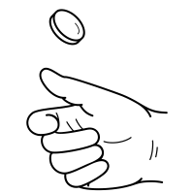
Classical Planning = No Uncertainty
We assume the state is known.
We assume all states in the problem are known.
We assume that we know all actions from the current state.
We assume that a given action will always execute as intended.
We assume that the successor states of action execution are also known.
Notes:
But in this video, I’m actually going to make everything even worse!
So already, we broke the rule that actions always execute as intended. We also broke the rule that the successor state of the action is a given.
Now, let’s get one step worse. What happens if we actually don’t know for certain what state we’re in anymore.

Slide 6
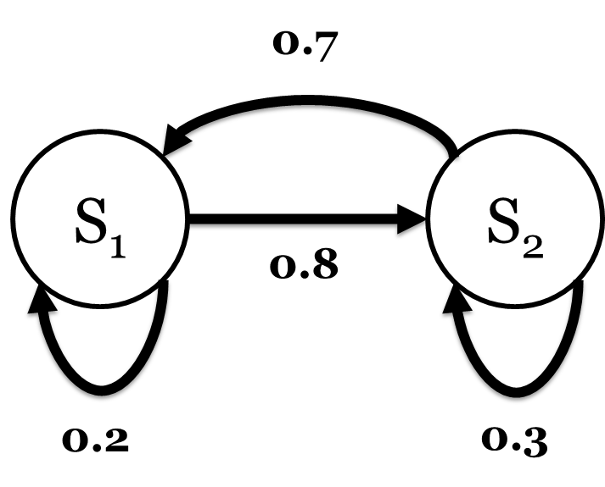
Hidden Markov Model
Same as before…
Modelling probabilistic transitions between states.
Probabilistic transition between states.
Rewards received at states.
But, the Markov Chain is now hidden.
States emit observations with a probability – which we can see.
Based on the observations, we can then guess what state we’re in.
S1 emits with p = 0.75
S2 emits with p = 0.75
Notes:
So if we don’t know for sure what state we’re in, we need to rely on some information that would allow us to make some sort of education assumption as to what state we’re in.
And this leads us to using what is known as a Hidden Markov Model. It’s exactly the same as the original Markov Models we saw in the last session: meaning that we model the states, the probability transitions between the states and we have some sort of reward when we reach the states.
BUT… we can’t actually see the Markov Chain. We know it exists, we know the states exist but, we can’t see them states.

Slide 7
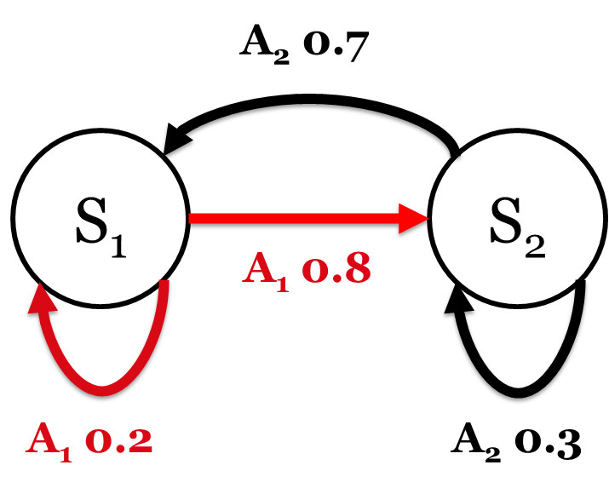
Partially Observable Markov Decision Process (POMDP)
Modelling probabilistic transitions between states.
Next state is only determined by probabilistic transition between states.
Does not factor the history of previous states.
But is unsure of what state we are in, reliant on observations to build history of states visited.
S1 emits with p = 0.75
S2 emits with p = 0.75
Notes:
And so if we then apply this principle to decision making, we have partially observable markov decision processes or POMDP.
This is a MDP where we can’t see the states, instead we are reliant on the observations that give us a rough approximation of what state we could be in and based on the actions we take, it will influence where we are.
I haven’t drawn a diagram of the POMDP at this stage, but it’s important to acknowledge that the MDP is still there, we just can’t see it. Essentially every state in the POMDP is a probability distribution over what states the MPD could current be in at this point in time.
And this becomes an increasingly complex process as we discuss how one observation can influence where we are now, but also subsequently, if we have a sequence of observations, can we then predict what action transitions we have made in the world?

Slide 8
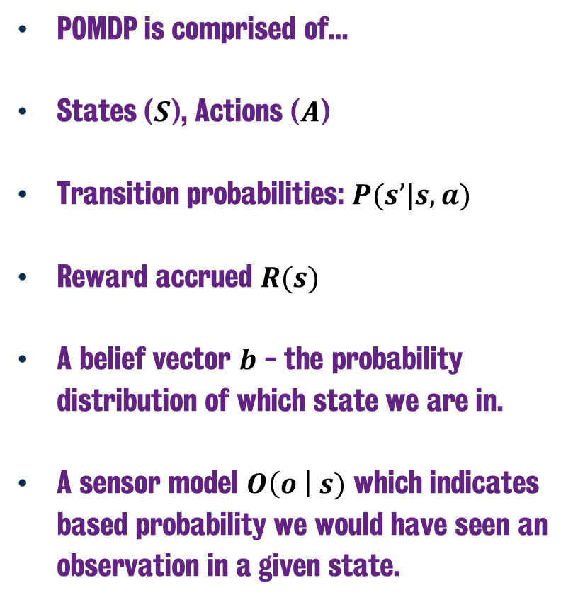
Partially Observable Markov Decision Process (POMDP)
POMDP is comprised of…
States ($S$), Actions ($A$)
Transition probabilities: $P(s’|s, a)$
Reward accrued $R(s)$
A belief vector $b$ - the probability distribution of which state we are in.
A sensor model $O\left(o \right| s)$ which indicates based probability we would have seen an observation in a given state.
A_{up} 0.1
A_{down} 0.8
S₁
S₂
S₂
A_{up} 0.8
S₃
S₁
S₃
A_{up} 0.1
A_{down} = 0.2
Notes:
So let’s take a look at the individual elements that a POMDP is comprised of.
Much like our MPD, it contains our model of states and actions, the as well as our transition probabilities of reaching s’, in state s, using action a. This is exactly the same as the MDP.
We also have our Reward values again, which is the R function applied to s.
But we also have two new elements, which we will discuss now.
First of all there is the belief vector, which is the probability distribution across all states of what state we could possibly be in right now. This vector when summed will of course reach a value of 1.
And lastly there is the sensor model, which tells us the probability that we received a given observation in a given state.
So let us walk through the new elements: namely the belief vectors and sensor model.

Slide 9
Partially Observable Markov Decision Process (POMDP)
So hang on… if we cannot see the Markov Model, how can we work with this?
We know it exists, we know what it looks like, we just can’t say what the current state is.
We rely on the observations to make assumptions of which state we are in.
We then take actions and rely on the subsequent observations to build a belief vector.
Notes:
So as I said it’s all about the observations, from the observations, we can then make some sort of intelligent assumption of where we are in the world.
It’s important once again to state the MDP exists, the states exist, we just can’t see any of it. We just don’t know what the current state is, hence we need to use the information of observations to help us figure that out.
Why is this relevant? Well it’s very much a reflection of real world behaviour: sensors on robots might be faulty and not 100% accurate. Hence we can’t say with any confidence we are where we think we are.
So returning to the grid world example from before, what if upon looking at this grid, I actually don’t know where I am. How can I make an intelligent decision on how to proceed?
To do this, we need to take the observations and then ask ourself to calculate the belief vector of where we are in the MDP.

Slide 10
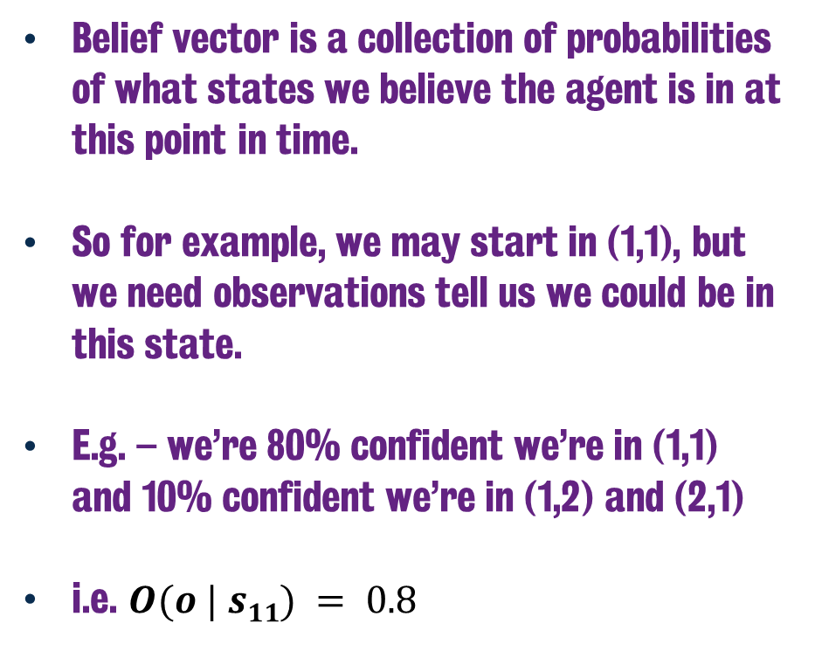
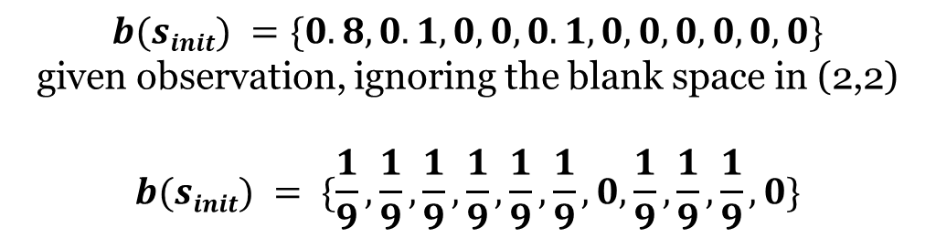
Belief Vector
(3,4)
Belief vector is a collection of probabilities of what states we believe the agent is in at this point in time.
So for example, we may start in (1,1), but we need observations tell us we could be in this state.
E.g. – we’re 80% confident we’re in (1,1) and 10% confident we’re in (1,2) and (2,1)
i.e. $O(o | s11) = 0.8$
?
?
?
(1,1)
$$b(sinit) =\{0.8,0.1,0,0,0.1,0,0,0,0,0,0\}$$
given observation, ignoring the blank space in (2,2)
$$b(sinit) = \{\frac{1}{9},\frac{1}{9},\frac{1}{9},\frac{1}{9},\frac{1}{9},\frac{1}{9},0, \frac{1}{9},\frac{1}{9},\frac{1}{9},0\}$$
Notes:
So the belief vector is the probability that we are in a given state. And this is a useful thing to model, given there is a chance that based on the observations we could be in multiple states.
If we consider that there’s an 80% chance we are in the starting state, which is that cell 1,1 in the bottom left hand corner. And a 10% chance we’re either in the cell above it or the cell to the right, then the belief vector will look like it does on the bottom of the screen. With 0.8 in the first entry, assuming that this list enumerates from 1,1 up to 4,4 but ignores 2,2 given that this cell is not possible to ever be at. So it’s not a valid state.
But of course all of this relies on us receiving that observation. So to begin without any observation, we have a 1/9 probability of being in any state that isn’t the goal

Slide 11
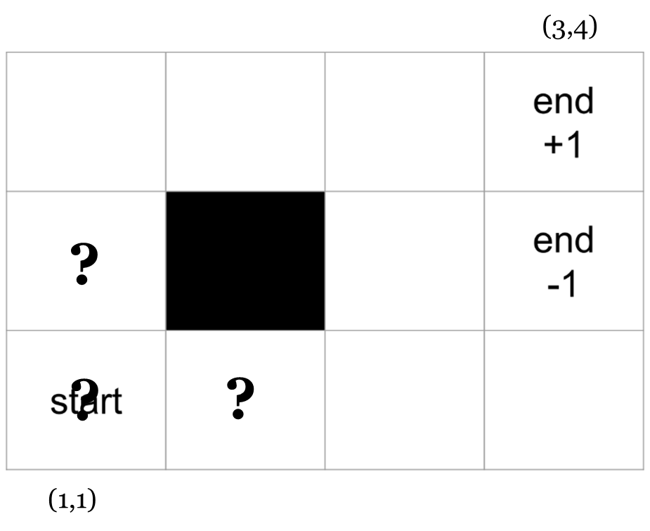
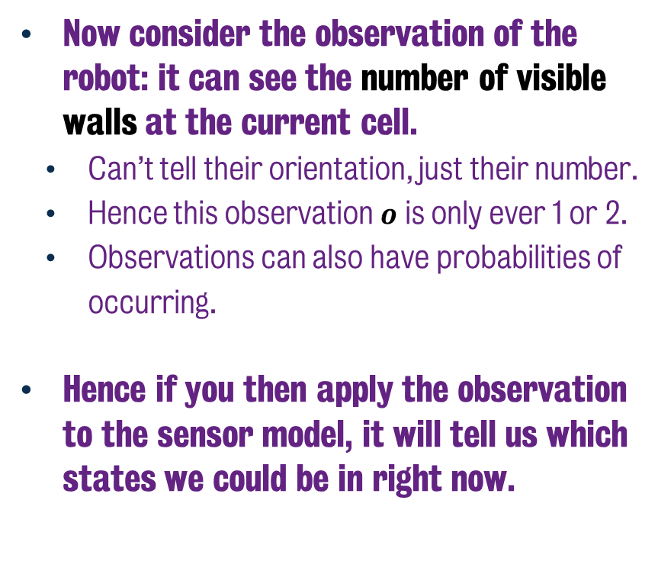
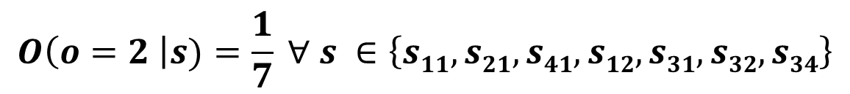
Calculating Belief from Observation
Now consider the observation of the robot: it can see the number of visible walls at the current cell.
Can’t tell their orientation, just their number.
Hence this observation $o$ is only ever 1 or 2.
Observations can also have probabilities of occurring.
Hence if you then apply the observation to the sensor model, it will tell us which states we could be in right now.
$$O\left(o=2 \right|s)=\frac{1}{7} ∀ s ∈\left\{s11,s21,s41,s12,s31,s32,s34\right\}$$
Notes:
Now given our belief state, we need to be able to compute that based on the observations. In this case, we can use the observations as evidence to support a given probability.
So say in each state, we receive an observation of how many walls there are in proximity of the robot. We don’t get the orientation, just the number. So in this example, there’s no cell where that value is less than 1. In fact the only cell that could have been is 2,2, but it’s blocked. Hence the value of this observation is only ever 1 or 2. And based on that we can then calculate what the probabilities are for the belief state, based on the observation.
In this case, if we see two walls, then we know we are in one of seven states in the grid, which I have marked, as being the possible states. Hence the belief vector sets a value of 1/7 or 0.143 for each of these cells and sets 0 for everything else.
Now it’s important to acknowledge the having this knowledge, such that I can say with confidence that based on the signal I know what state I am in, has to be something that is pre-built into the model. If I can’t determine that (1,1) has two walls surrounding it beforehand, then receiving this observation really isn’t important.

Slide 12
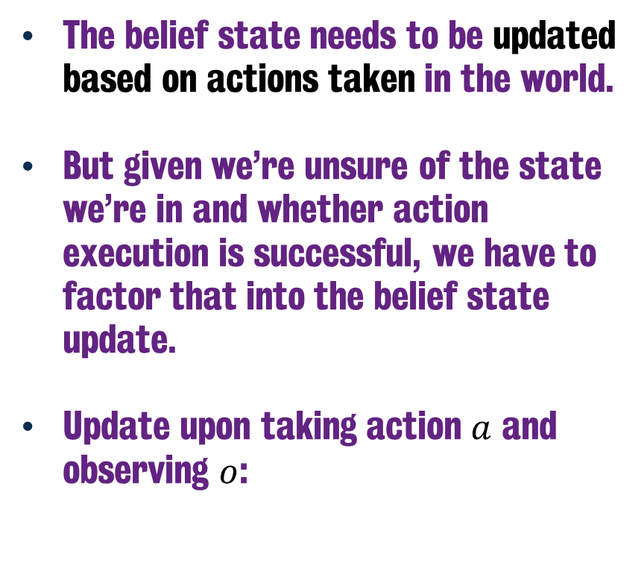
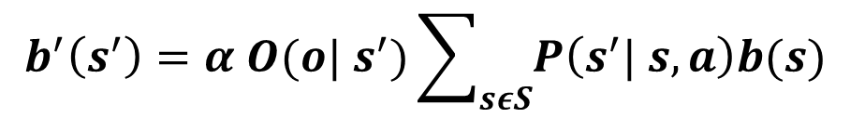
Calculating Belief from Observation
The belief state needs to be updated based on actions taken in the world.
But given we’re unsure of the state we’re in and whether action execution is successful, we have to factor that into the belief state update.
Update upon taking action $a$ and observing $o$:
$$b^{′}\left(s^{′}\right)=α O({o| s}^{′})\sum_{sεS}{P\left(s^{′}| s, a\right)b(s)}$$
Notes:
Now in the event we taken an action, that belief state needs to be updated. But of course we not only are not sure of the state we’re in as well as whether the action executes as intended.
This means that the belief state update is actually pretty complicated, given we need to execute the action, await an observation and then run a calculation to based on:

Slide 13
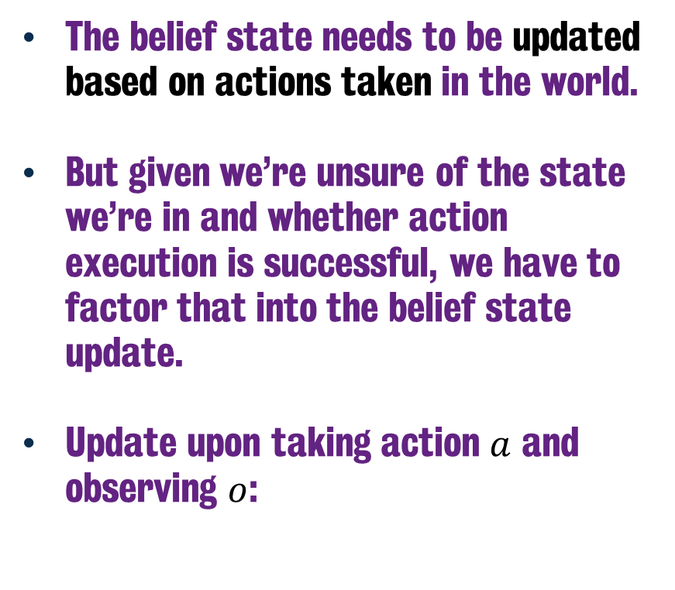
Calculating Belief from Observation
The belief state needs to be updated based on actions taken in the world.
But given we’re unsure of the state we’re in and whether action execution is successful, we have to factor that into the belief state update.
Update upon taking action $a$ and observing $o$:
$$b^{′}\left(s^{′}\right)=α O({o| s}^{′})\sum_{sεS}{P\left(s^{′}| s, a\right)b(s)}$$
Notes:
The probability that we are likely to see observation o at state s’ given action a.

Slide 14
Calculating Belief from Observation
The belief state needs to be updated based on actions taken in the world.
But given we’re unsure of the state we’re in and whether action execution is successful, we have to factor that into the belief state update.
Update upon taking action $a$ and observing $o$:
$$b^{′}\left(s^{′}\right)=α O({o| s}^{′})\sum_{sεS}{P\left(s^{′}| s, a\right)b(s)}$$
Notes:
The probability that we are likely to see observation o at state s’ given action a.
Multiplied by the sum of probabilities of successful action transition from state s to s’, given the belief state that you were in that state to begin with.

Slide 15
Calculating Belief from Observation
The belief state needs to be updated based on actions taken in the world.
But given we’re unsure of the state we’re in and whether action execution is successful, we have to factor that into the belief state update.
Update upon taking action $a$ and observing $o$:
$$b^{′}\left(s^{′}\right)=α O({o| s}^{′})\sum_{sεS}{P\left(s^{′}| s, a\right)b(s)}$$
Notes:
The probability that we are likely to see observation o at state s’ given action a.
Multiplied by the sum of probabilities of successful action transition from state s to s’, given the belief state that you were in that state to begin with.
And it’s worth acknowledging that alpha is what is known as a normalising constant, that makes the belief state sum up to 1.
Being able to calculate and update the belief state is beyond the scope of this module, but knowing this is how it works is important.

Slide 16
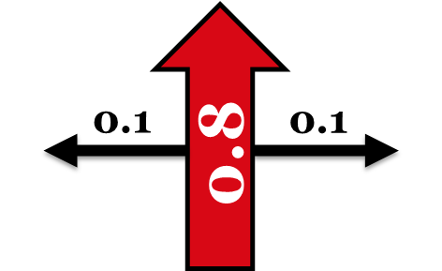
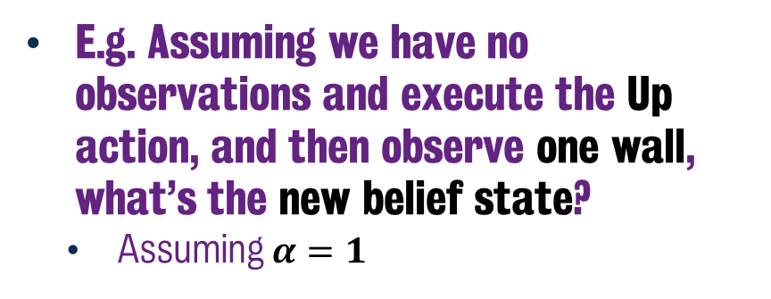
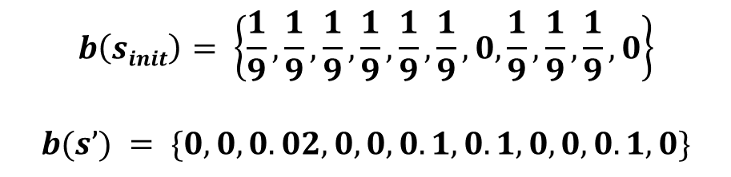
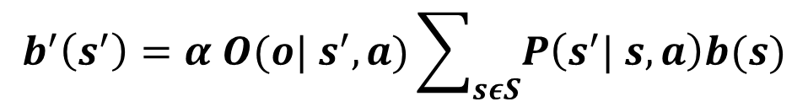
Calculating Belief from Observation
E.g. Assuming we have no observations and execute the Up action, and then observe one wall, what’s the new belief state?
Assuming $α=1$
$$b\left(sinit\right)= \left\{\frac{1}{9},\frac{1}{9},\frac{1}{9},\frac{1}{9},\frac{1}{9},\frac{1}{9},0, \frac{1}{9},\frac{1}{9},\frac{1}{9},0\right\}$$
$b(s’) = \{0,0,0.02, 0, 0, 0.1, 0.1,0, 0, 0.1, 0\}$
Problem that the normalisation constant needs to be more useful.
$$b^{′}\left(s^{′}\right)=α O({o| s}^{′}, a)\sum_{sεS}{P\left(s^{′}| s, a\right)b(s)}$$
Notes:
So if we were to update based on the assumption that we we had a uniform distribution of probabilities across all non-terminal states and then executed the up action what would our belief state look like?
Now if we were to execute this with a normalisation value of 1, then it would result in us eliminating certain states, in fact there are only four here it could be.
But…. The actual probabilities are not great and that’s why the normalisation constant is often denoted differently.

Slide 17
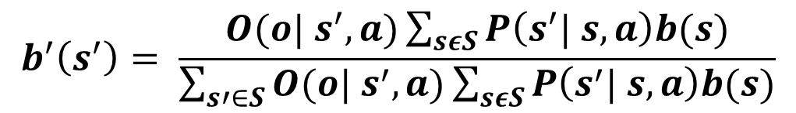
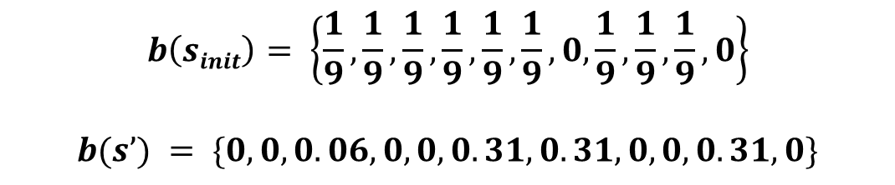
Calculating Belief from Observation
E.g. Assuming we have no observations and execute the Up action, and then observe one wall, what’s the new belief state
$$b^{′}\left(s^{′}\right)= \frac{O({o| s}^{′}, a)\sum_{sεS}{P\left(s^{′}| s, a\right)b(s)}}{\sum_{s′∈S}{O({o| s}^{′}, a)}\sum_{sεS}{P\left(s^{′}| s, a\right)b(s)}}$$
$$b\left(sinit\right)= \left\{\frac{1}{9},\frac{1}{9},\frac{1}{9},\frac{1}{9},\frac{1}{9},\frac{1}{9},0, \frac{1}{9},\frac{1}{9},\frac{1}{9},0\right\}$$
$b(s’) = \{0,0,0.06, 0, 0, 0.31, 0.31,0, 0, 0.31, 0\}$
Notes:
Typically the normalisation factor can be considered as 1/ the sum of observation probabilities in s’ multiplied by the probability of reaching s’ based on action a, given belief state s.
By doing this instead, we result in a much stronger set of probabilities for the belief state.
Now one thing I haven’t even tackled, is how we would go about solving the policy for this POMDP, but it can be approached in a similar manner to regular MDP using the likes of value iteration. But it becomes increasingly more complex given we’re now required to factor the believe states and observation probabilities.

Slide 18
Summary
Markov Models | Uncontrolled Transitions | Actions
States Fully Observable | Markov Model | Markov Decision Process
States Partially Observable | Hidden Markov Model | Partially Observable Markov Decision Process
Notes:
And so to wrap up this segment, given we’re only interested in discussing how these we model these systems, rather than how we solve them. This table is more or less a summary of the key issues.
Markov Chains are available in fully observable state systems, albeit we do not infer any intentionality in the transitions. When we want to start giving that intentionality, that’s when it becomes a Markov Decision process and we inject the reward system such that

Slide 19
Classical Planning
Partially Observable
Markov Decision Processes
6CCS3AIP – Artificial Intelligence Planning
Dr Tommy Thompson

